Slide 1
Building an App A-Z
Lecturer: Orla McMahon

Slide 2
Building a Web Application
4 Important Aspects
Wireframing/Ideas
This involves sketches and a basic plan of what app will do.
Content
Design
Interactivity
Setting up the page

Slide 3
Wireframing
YouTube
https://www.youtube.com/watch?v=vXLDqaH9vkE
https://www.youtube.com/watch?v=RjIDHTyY1zM
Loads more on youTube…..

Slide 4
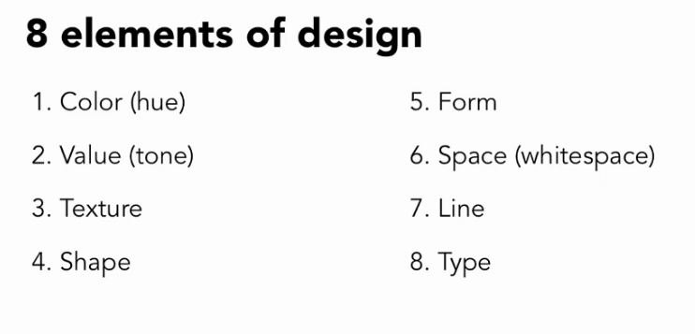

Slide 5
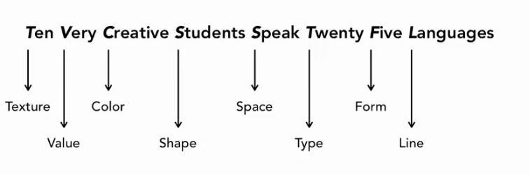

Slide 6
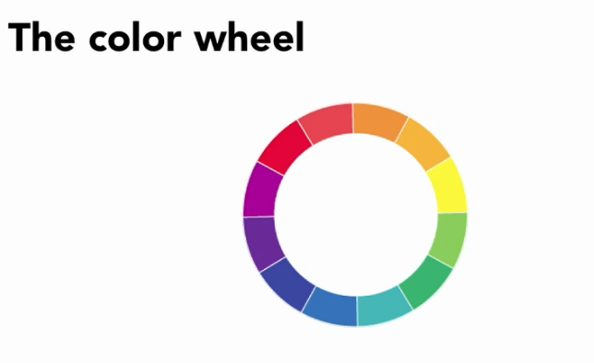
1. Colour

Slide 7
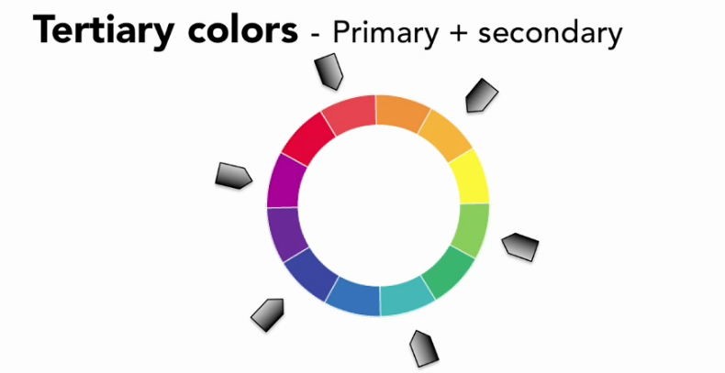
1. Colour
Notes:
Primary colours are normally red, yellow and blue

Slide 8
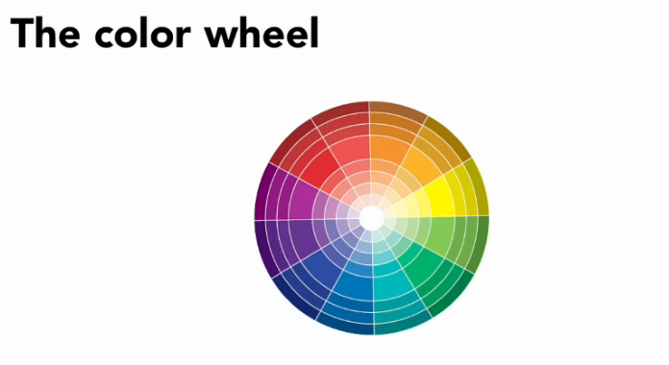
1. Colour

Slide 9
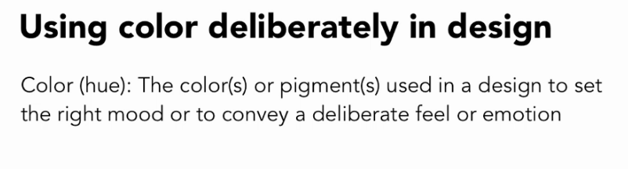
1. Colour

Slide 10
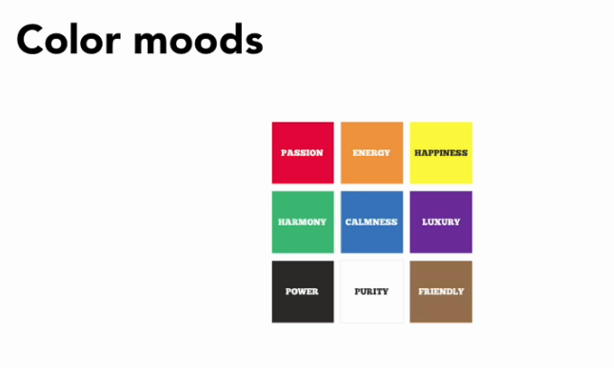
Many businesses use colours to represent their brands
Bakeries use pastel colours
Banks favour more conservative dark navy blue,

Slide 11
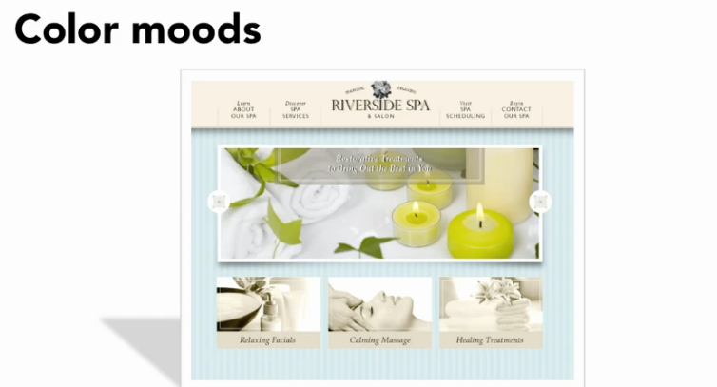
1. Colour

Slide 12
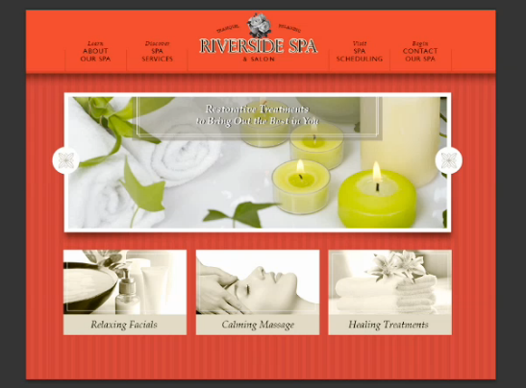
1. Colour
Not very relaxing…..

Slide 13

1. Colour
Think about the mood that you want to project

Slide 14
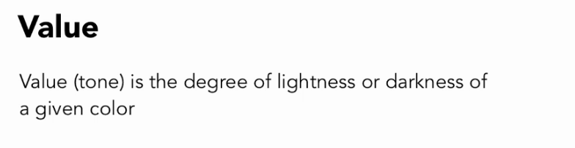
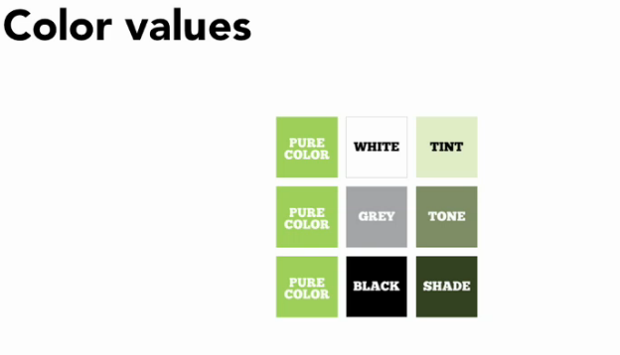

Slide 15
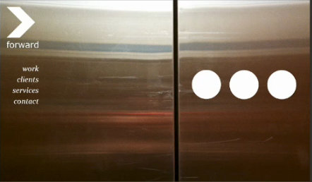
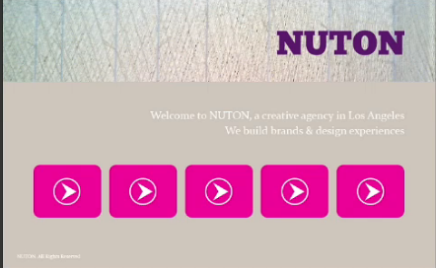
2. Value (Tone)
Any light detail on a dark background is the
1st place that the eye will go to.

Slide 16

2. Value (Tone)
Use colours strategically to create the illusion of depth

Slide 17
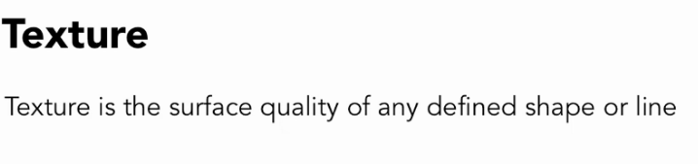
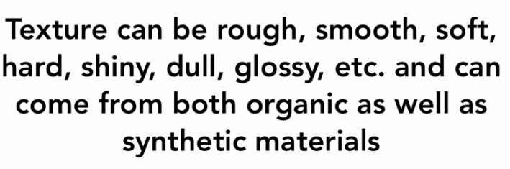
3. Texture

Slide 18
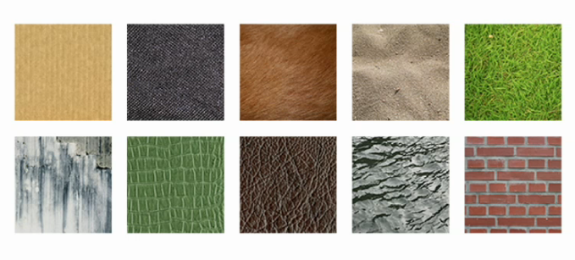
Texture Examples

Slide 19
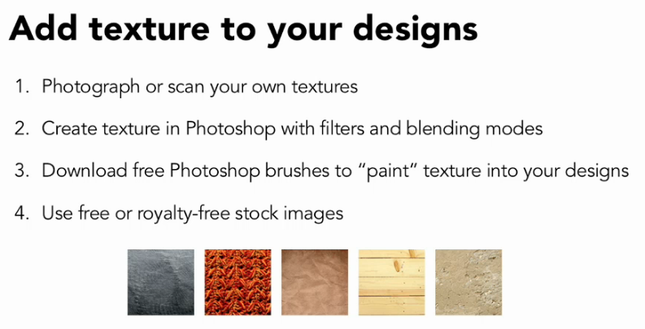
3. Texture

Slide 20
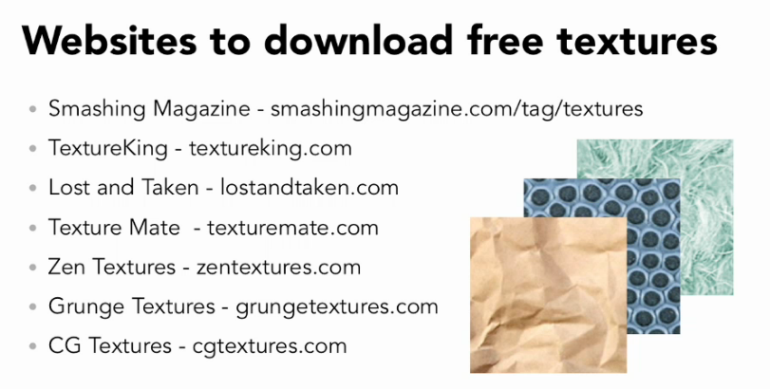
3. Texture
http://www.smashingmagazine.com/2009/01/07
/textures-in-modern-web-design/

Slide 21
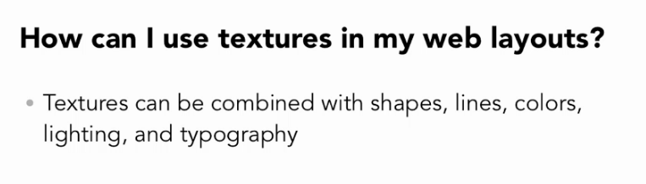
3. Texture

Slide 22
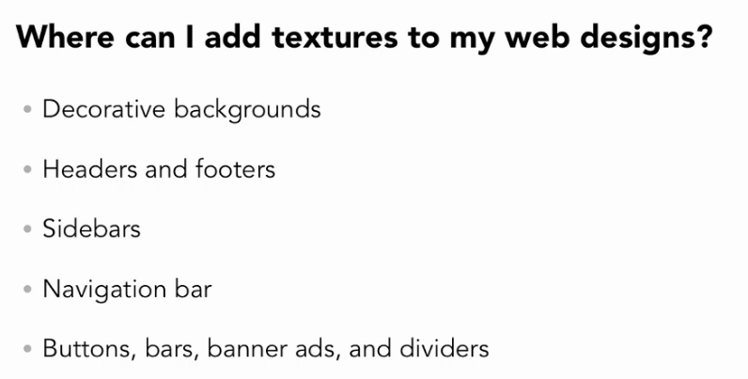
3. Texture

Slide 23
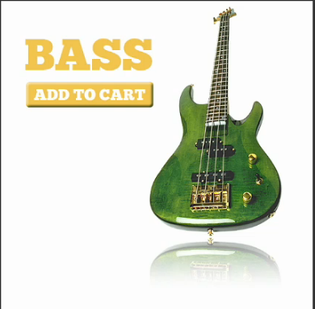
Texture Examples
Lets look at some examples –
Reflective surface

Slide 24

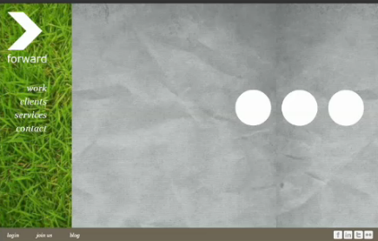
Texture Examples
Textures with photographs
Use textures on headers footers, navigation bars, etc.

Slide 25
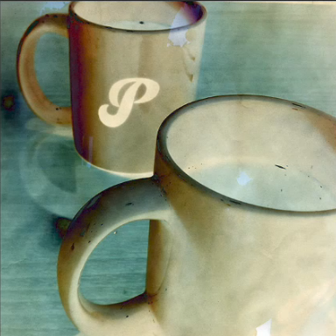
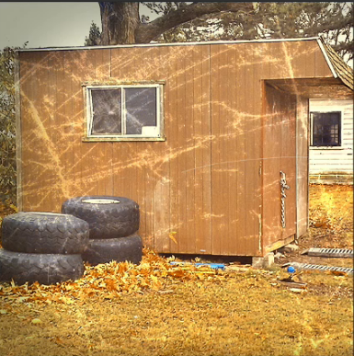
Texture Examples

Slide 26
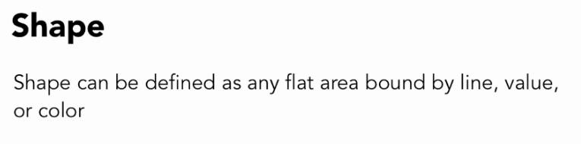
4. Shape

Slide 27
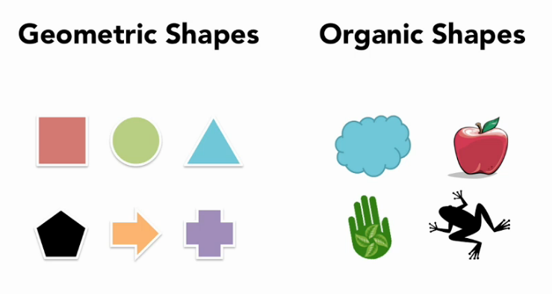
4. Shape

Slide 28
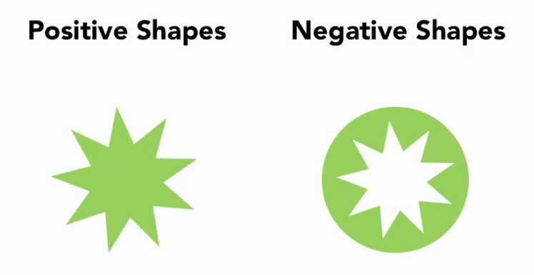
4. Shape

Slide 29
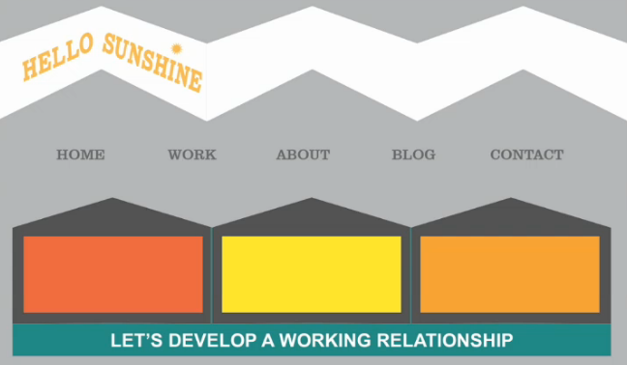
Shape Examples

Slide 30
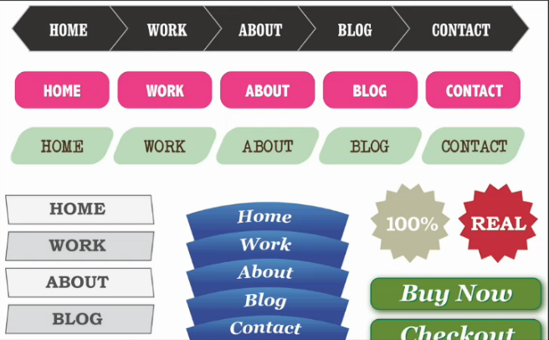
Shape Examples
Repeat similar shapes

Slide 31
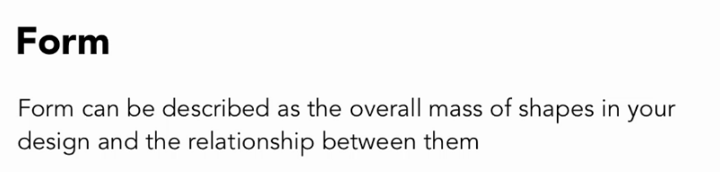
5. Form
Consider the group of shapes as a whole – the structure of the design
Doing it well takes time - screen design
Good Form shows that it all fits together and nothing is out of place
One Trick -
Plan and execute your designs in black and white 1st
Build site with form in mind so that whole design makes sense
Success when ready to add colour

Slide 32
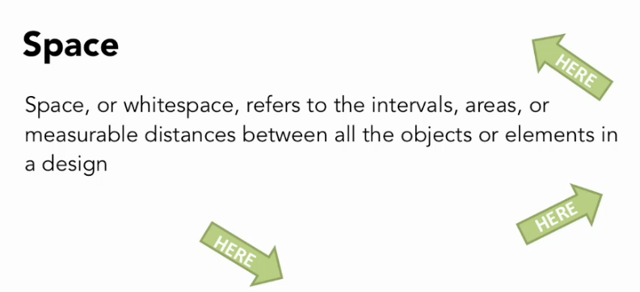
6. Space

Slide 33
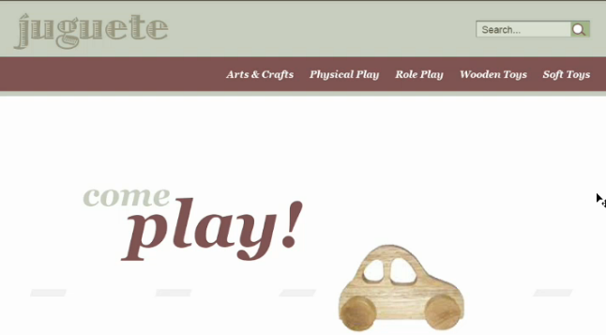
6. Space
Resist temptation to fill in all the gaps
So that eye has a place to rest between all elements -

Slide 34
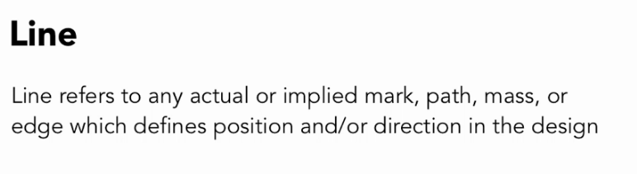
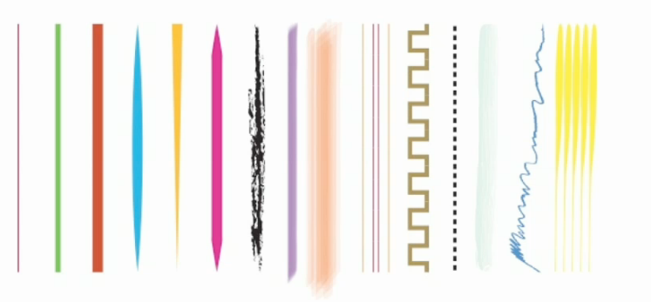
7. Line

Slide 35


7. Line Examples

Slide 36
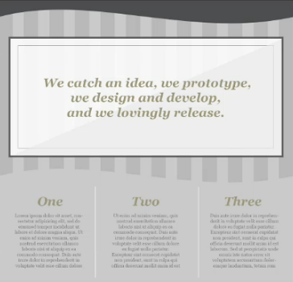
7. Line Examples
Use lines as dividers to separate each area

Slide 37
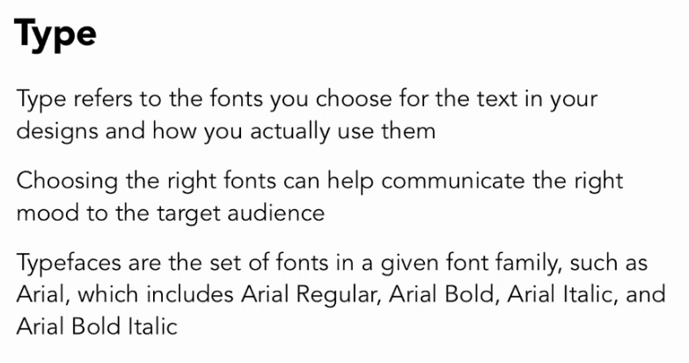
8. Type

Slide 38
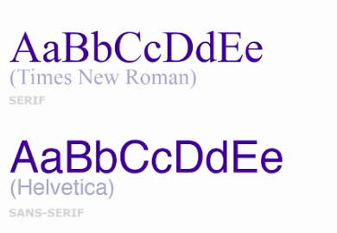
8. Type Examples

Slide 39
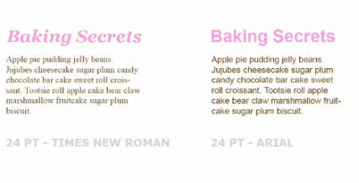
8. Type Examples
Which is easier to read?

Slide 40
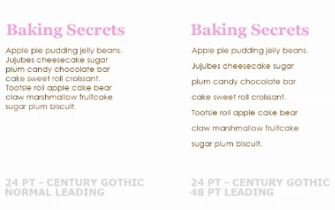
8. Type Examples
Need to take into account style, size, weight, height and leading
Your site should be easy to read and understand at a glance

Slide 41
WebSite Design
Examples
http://graphicdesign.about.com/od/career/a/ask_clients.htm
http://www.smashingmagazine.com/2009/01/07/textures-in-modern-web-design/

Slide 42
Building a Web Application
4 Important Aspects
Wireframing/Ideas
This involves sketches and a basic plan of what app will do.
Content
Design
Interactivity
Setting up the page

